Slide 1
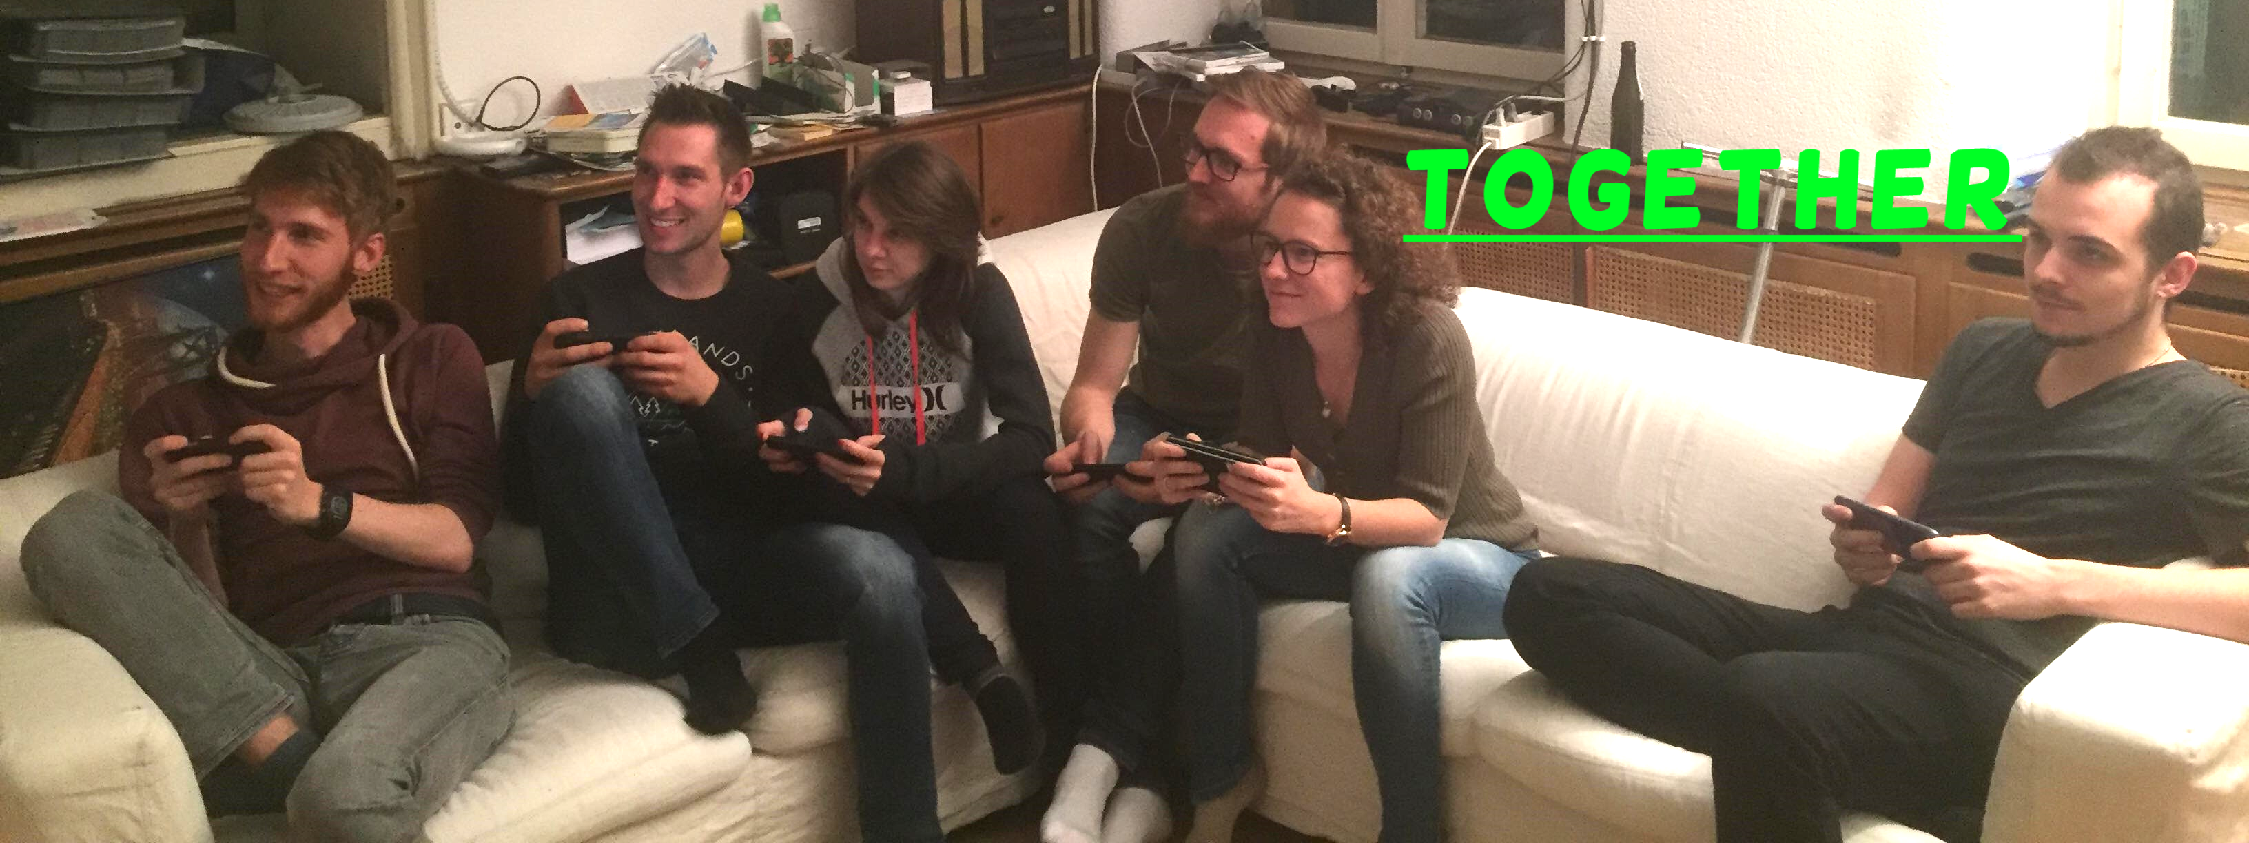
Generic Smartphone Game Controller
Bachelor Thesis
Flückiger Quentin
Notes:
Welcome to presentation of bachelor thesis.
The topic I chose is Generic ….
And I will start this presentation with a little story.

Slide 2
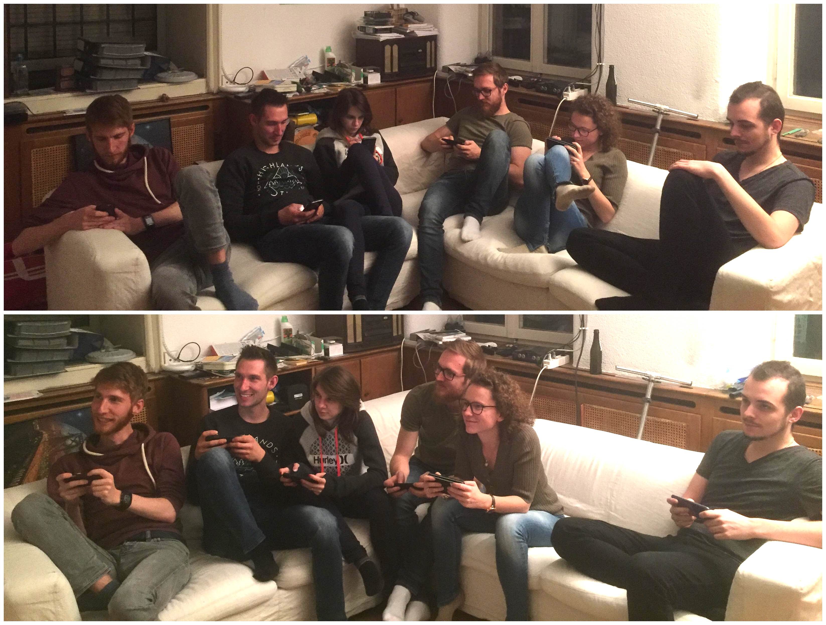
Notes:
I think those numbers don’t surprise anyone as very often we see on the streets, in buses, trains, pretty much everywhere, people playing on their smartphone.
Even though those games might be good, they tend to isolate people and make them play in their corner. But what if we would make them play together.
Talk about the POINT of together
Is there a market for it ? Make it dramatic

Slide 3
Device based comparison
Notes:
If we look in detail at the video game market we can see that the incomes generated by mobile games are around 50% of the globale amount.

Slide 4
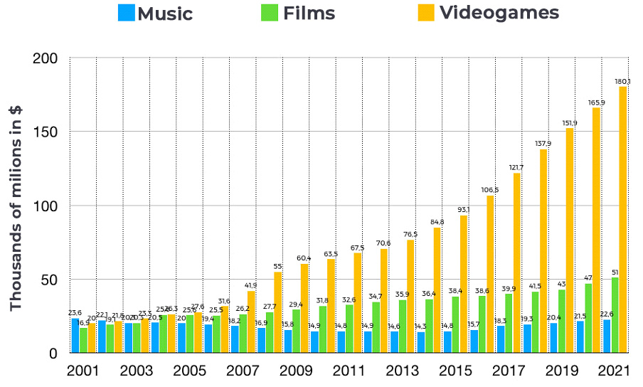
Revenue comparison
Notes:
As you can see on this chart comparing Music, Movies (TV-Show not included) and videogames.
And if we look at the revenue of the digital entertainement industry we can see that video games are far above the other category and is indeed lucrative.

Slide 5

Goals
Use smartphones as a smart controller for video games played on computer
Notes:
But what where actually my goals ?
The main goal was to create a platform which would use smartphones as controllers and a computer screen as the palce where the game is playing.
It had to be multiplayer.
I wanted to make this platform generic to allow the possibility to implement more easily games for this software.

Slide 6
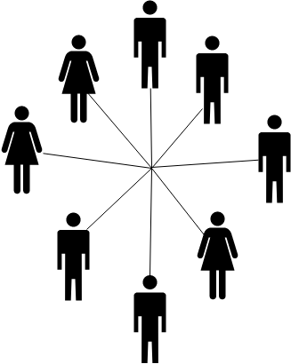
Goals
Use smartphones as a smart controller for video games played on computer
Multiplayer games
Notes:
But what where actually my goals ?
The main goal was to create a platform which would use smartphones as controllers and a computer screen as the palce where the game is playing.
It had to be multiplayer.
I wanted to make this platform generic to allow the possibility to implement more easily games for this software.

Slide 7

Goals
Use smartphones as a smart controller for video games played on computer
Multiplayer games
Generic platform
Notes:
But what where actually my goals ?
The main goal was to create a platform which would use smartphones as controllers and a computer screen as the palce where the game is playing.
It had to be multiplayer.
I wanted to make this platform generic to allow the possibility to implement more easily games for this software.

Slide 8
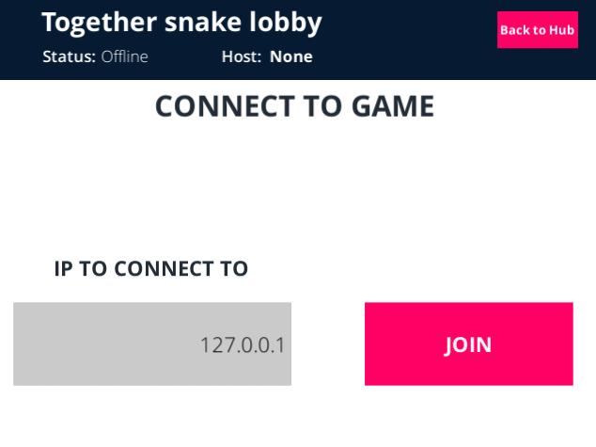
Framework
Using Unity3D
Generic

Slide 9
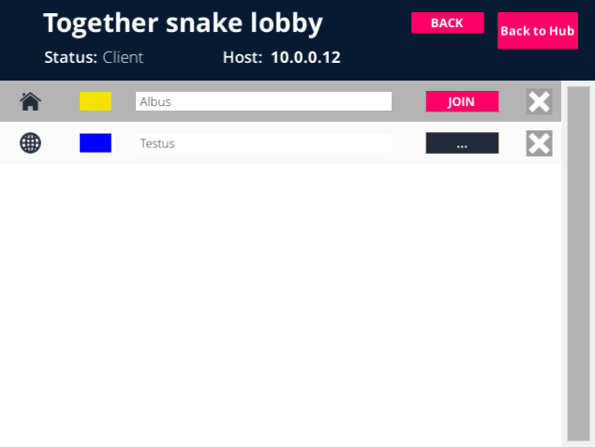
Framework
Using Unity3D
Generic

Slide 10
Framework
Using Unity3D
Generic
Implemented two games as example

Slide 11
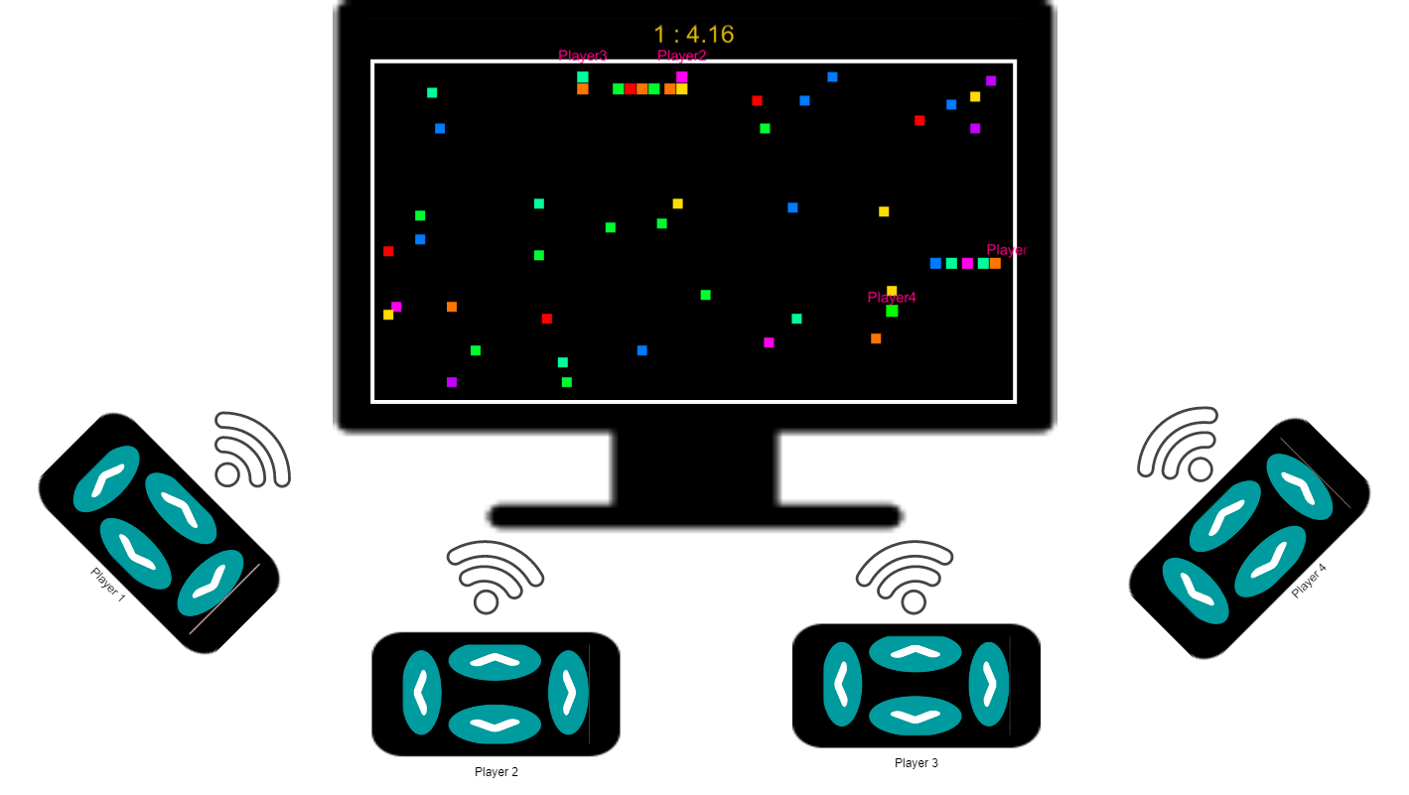
Games
Snake Game
1-4 players
Simple rules
Simple controller
Notes:
Snake game: You play as a little snake whose goal is to eat apple to grow bigger, but be aware of the walls and snake tails. No look at controller.
Here 4 players
We could use our phone for more than just basic input data, personal information
Domino: You have dominos in your hand, cards with two values, and you need to empty your hand by placing them on the board in turn. Here the smartphone is at the core of the game, and you need to look at it during the game.

Slide 12
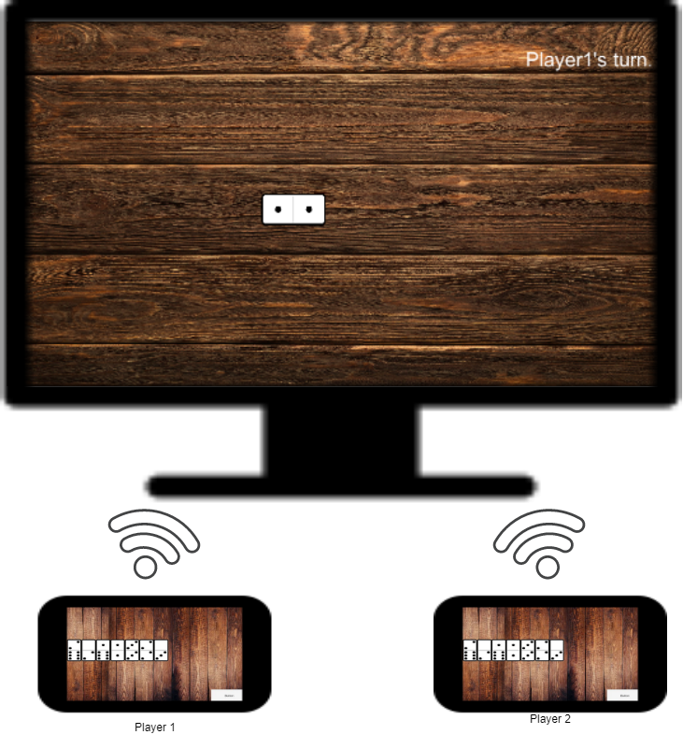
Games
Domino Game
2 players
Kind of a card game
Smarter controller
Notes:
Snake game: You play as a little snake whose goal is to eat apple to grow bigger, but be aware of the walls and snake tails. No look at controller.
Here 4 players
We could use our phone for more than just basic input data, personal information
Domino: You have dominos in your hand, cards with two values, and you need to empty your hand by placing them on the board in turn. Here the smartphone is at the core of the game, and you need to look at it during the game.

Slide 13

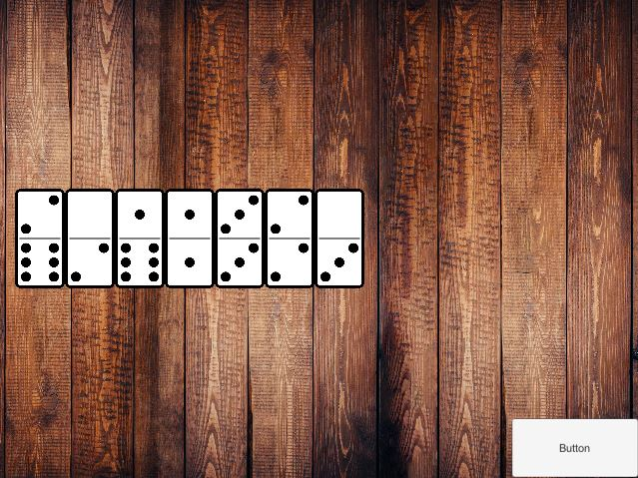
Controllers
Snake Controller
Domino Controller
Notes:
Here you can

Slide 14
Demo

Slide 15
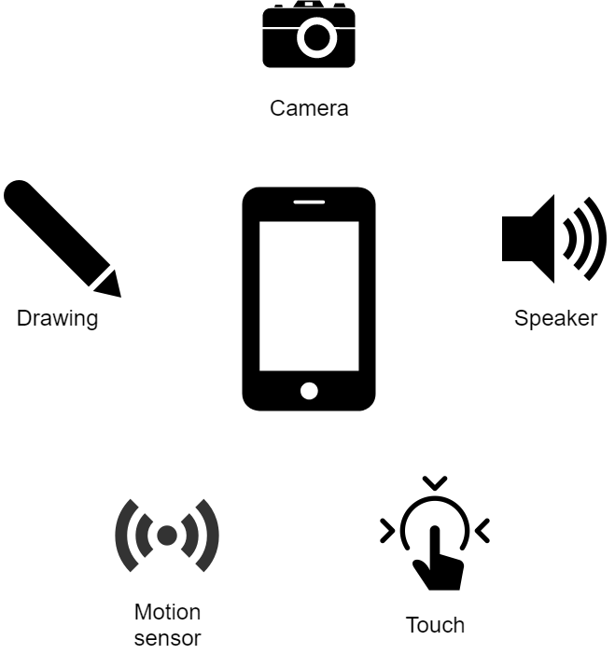
Conclusion
Incredible amount of possibilities
Technical
Notes:
The possibilities using a smartphone as a controller are huge, a game using the motion sensor of the phone could be developed, or the camera, speakers.

Slide 16
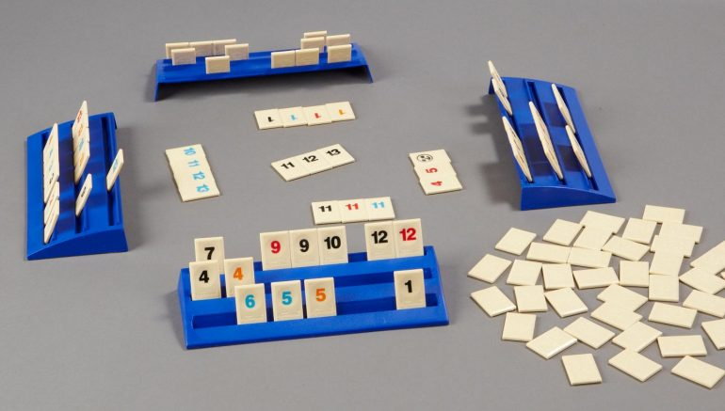
Conclusion
Incredible amount of possibilities
Technical
Conceptual
Notes:
Or conceptual, benefit of having it’s own hidden information. Team game, where information are shared between team members, hide strategy….

Slide 17
Conclusion
Incredible amount of possibilities
Technical
Conceptual
Reusability
Notes:
Generic part

Slide 18
Question(s) ?
Notes:
Thank you for your time and attention

Slide 19
Sources
1. https://lpesports.com/e-sports-news/the-video-games-industry-is-bigger-than-hollywood
2. https://buildfire.com/ios-android-users/
3. https://www.gamesforyoungminds.com/blog/2018/10/15/rummikub-a-classic-rummy-based-tile-game

